Slide 1
Case Study EDA
Kalen Asberry, Brandon Sucrese

Slide 2
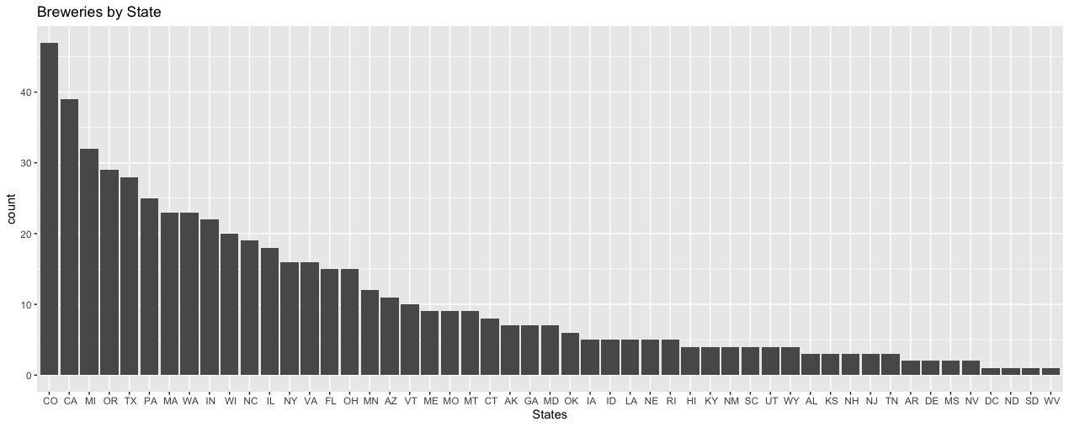
Question 1: Brewery Count

Slide 3
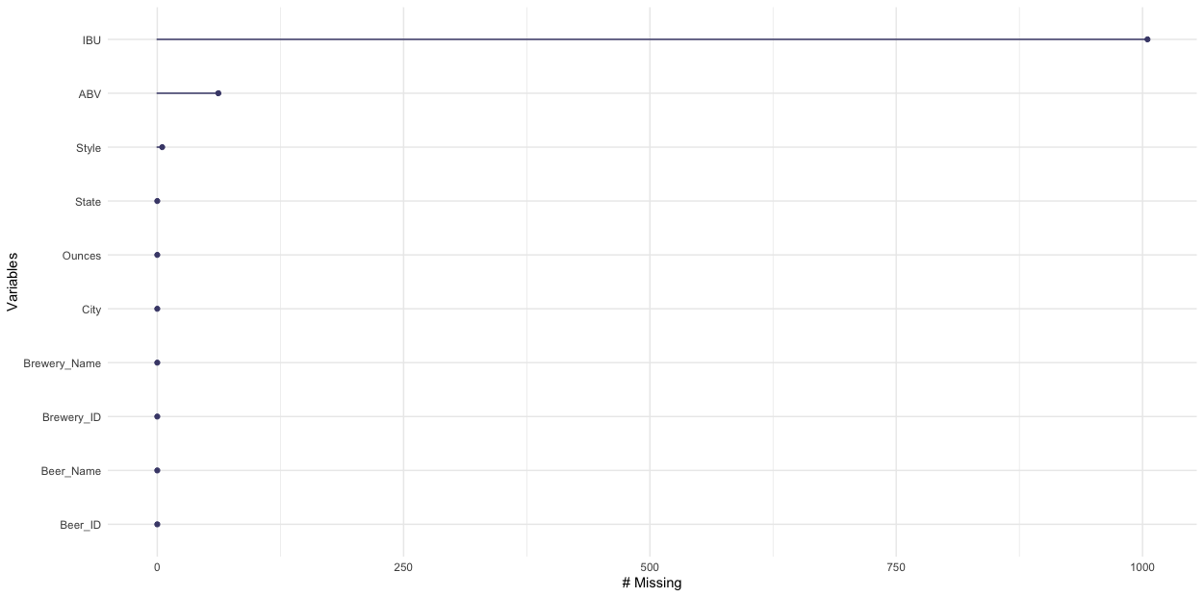
Question 3: Missing Values
Strategies to Solve Missing Values Issue
No Replacement
Mean / Median Replacement
Software / Package Replacement (MICE)

Slide 4
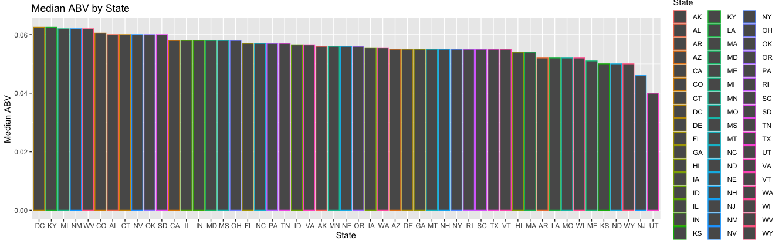
Question 4: Median Alcohol Content

Slide 5
Question 5: Max ABV and IBU
 | Beer Name | ABV | IBU | Style | Brewery Name | City | State
Max ABV | Lee Hill Series Vol. 5 (2565) | 0.128 | NA | Quadrupel | Upslope Brewing Company | Boulder | CO
Max IBU | Bitter Bitch Imperial IPA (980) | 0.082 | 138 | American Double / Imperial IPA | Astoria Brewing Company | Astoria | OR

Slide 6

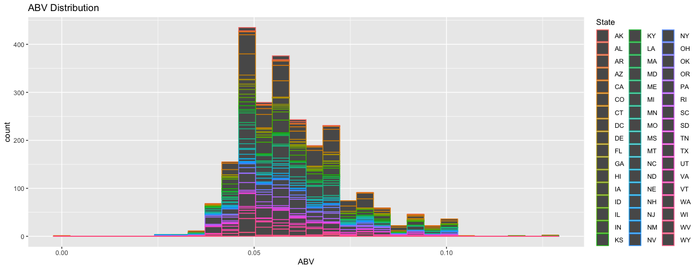
Question 6.1: ABV Distribution and Statistics

Slide 7
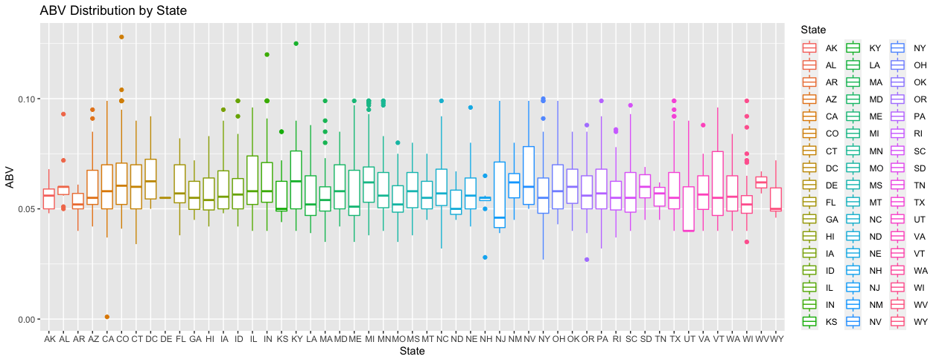
Question 6.2: ABV Distribution and Statistics

Slide 8
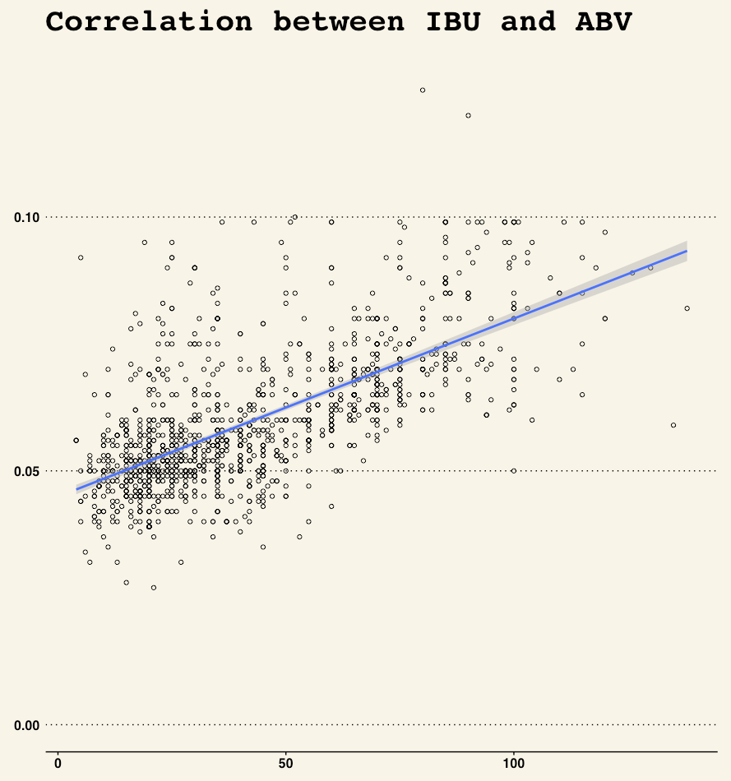
Question 7
With the a large positive correlation the evidence shows that as IBU goes up so does ABV. Concluding that there is a correlation between the two variables.

